Slide 1

HonorHealth Research Institute (HRI)
2020 Accomplishments

Slide 2


HonorHealth Research Institute (HRI) Neuroscience Program
The Neuroscience research program is embarking on a neuroscience biobanking endeavor in partnership with the HRI research laboratory team to open June 2021, and under the leadership of physician’s Todd Levine, MD and John Wanebo, MD.
  This program will support brain tumor, ALS, Parkinson’s disease, Dementia (inclusive of Alzheimer’s disease) headache, and migraine biobanking opportunities.
42 active neuroscience studies, 19 more in the start-up process and 39 studies potentially coming to our community rapidly.

Slide 3


Brain Tumor Clinical Trials
In partnership with the Ivy Brain Tumor Center, HonorHealth Research Institute is currently enrolling brain tumor patients into multiple clinical trials. These trials are designed to:
Personalize treatment options to the individual patient
Test novel, targeted therapies for brain tumors
Ease the care process for patients
For more information, call 480-583-3191 or visit
HonorHealth.com/neuroscience-research

Slide 4

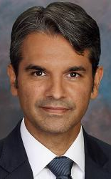
Neuroscience
Stroke Research
Dr. Ashu Jadhav, new HonorHealth stroke medical director joined HonorHealth in July 2020.
HonorHealth Scottsdale Osborn Medical Center received the DNV Primary Stroke Plus (PSC+) accreditation. HonorHealth is the first hospital in Arizona to receive this accreditation.
HonorHealth Research Institute is part of the DNV accreditation process and is a requirement to receive the award.
Stroke research portfolio is launching six clinical trials and four trials are additional potential trials to offer the community.

Slide 5

HonorHealth Research Institute (HRI) COVID-19 Research Program
The COVID-19 Research Team Created in March 2020 to meet the needs of our community
  Reviewed approximately 110 study protocols
  HRI has opened 12 new COVID-19 studies for our patients in four of our six HonorHealth hospital locations
  Offering potentially lifesaving therapeutics for improving respiratory function and reducing the inflammatory effect associated with COVID-19
  Ongoing education for our HonorHealth physicians and nursing teams for awareness of research treatment options for COVID-19 patients in the hospitals

Slide 6

COVID-19 Research
Over 2,000 patients have been considered for investigational treatment for COVID-19 clinical trials in three HonorHealth hospital locations.
1,100 patients have been treated under COVID-19 clinical trials

Slide 7

COVID-19 Research Studies
Redhill: HRI tied for #1 enroller in the United States out of 9 national sites
Veru: #1 enroller in the US out of 5 total sites
Incyte: First southwest site to enroll patients in the study out of 35 total sites in the US

Slide 8

Oncology Research
Dr. Jasgit Sachdev and the HRI Oncology Breast Research program was featured in the October 2020 issue of Scottsdale Airpark News
“Often times, we are the first ones in the world evaluating a potentially promising new cancer medication.” Jasgit C. Sachdev, MD
Over the past 15 years since the research institute began in 2005, over 16 drugs involved in HRI oncology clinical trials have led to FDA approvals.

Slide 9
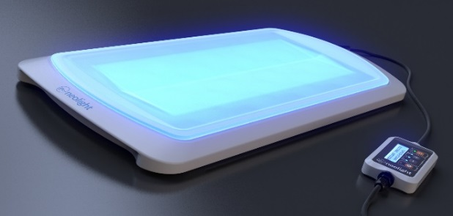
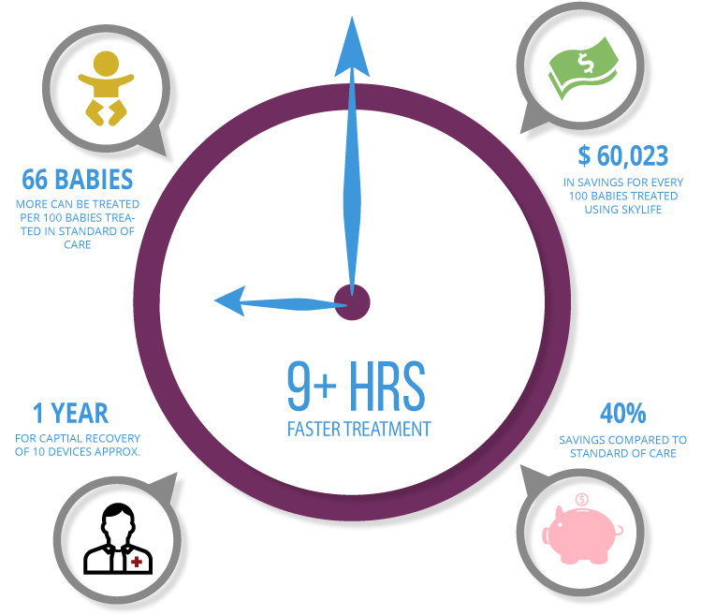


Neolight Skylife Phototherapy Evaluation Results

Slide 10
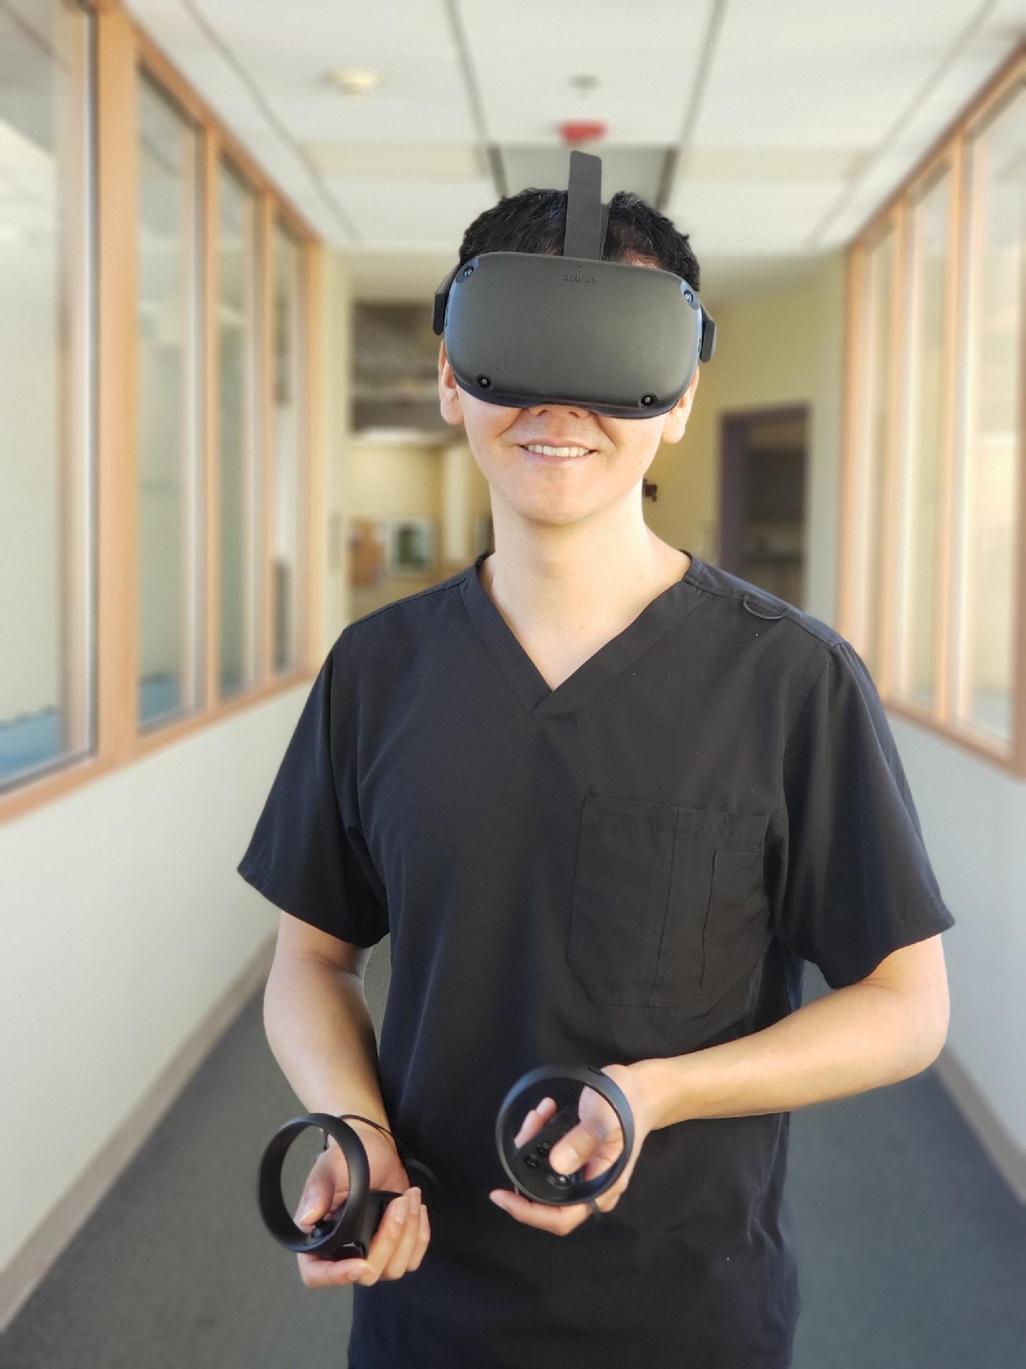
Virtual Reality (VR) Technology
Utilized in Oncology Research
Virtual Reality is a three-dimensional, computer generated environment which can be explored and interacted with by patients
Novel VR hardware technology with cloud-based content allows greater flexibility and lower cost
provided a grant by the Flinn Foundation to use Virtual Reality (VR) technology to improve patient understanding of medical, regulatory and legal aspects of the patient consent process and improve health literacy
Pilot study with 24 patients to consent for port placement by VR technology

Slide 11
VIRTUAL REALITY (VR) TECHNOLOGY
Collaboration with Microsoft and Dr. Mar Gonzalez Franco
Microsoft donated studio time for the production of the VR pilot
Collaboration with Emblematic for immersive medicine
Development of consortium for immersive medicine including Dr. Kristina Lerman at University of Southern California – Project Leader at the Information Services Institute

